Slide 1



Slide 2

Agenda
Overview
Our Comprehension
Experience

Slide 3

About BIAS
Founded in 2000. 20+ Years of Business expertise.
Oracle Platinum Partner
Oracle Global Partner of the Year
7x Oracle Excellence Award
Recognized as the Representative Vendor in Oracle Cloud Infrastructure by Gartner 2021

Slide 4

Services
Cloud Migration – Plan, Migrate and Optimize
Cloud Administration and Management
Cloud and Data Security Solutions
Database Management
On-Premise Systems
Service Desk and Assistance

Slide 5

Types of Projects
Development
Upgrade
Support and Maintenance

Slide 6

“Creating a better future for our customers, employees and community”

Slide 7

“We leverage technology to solve business challenges and deliver innovative solutions with expertise, hard work and passion”

Slide 8

TruNorth Vision
One Team for Delivery and Presales
Build Accelerators and Automations
Expand into new cloud infrastructures – Microsoft, Okta, Mulesoft
Geo expansion
Build 2nd line of leadership

Slide 9

One Team
Connect with Community
Exceed the mission
Embrace Diversity
Forever Innovation
CORE VALUES
Adopt a Growth Mindset
Unwavering Integrity
Be the Spark

Slide 10


Slide 11

IT Support
Corporate Etiquettes

Slide 12

Managing all resources of a business in a centralized way

Slide 13
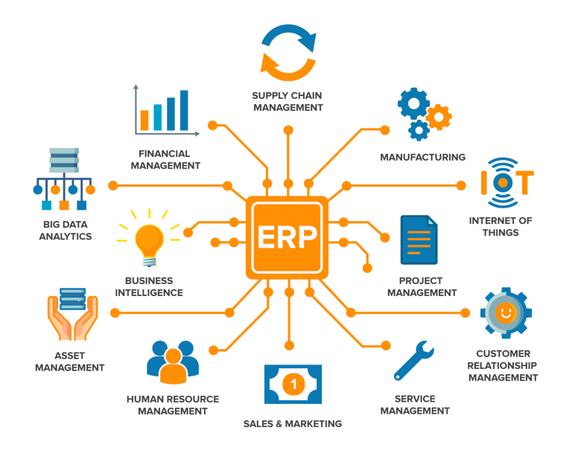

Slide 14



Types of ERP Deployment
Cloud ERP
On-premise ERP
Hybrid ERP (Cloud + On-premise)

Slide 15

Applications
Oracle E-Business Suit (EBS)
Oracle Hyperion
Oracle JD Edwards
Database
MySQL
Oracle Database

Slide 16

FUSION MIDDLEWARE
Software that comes in-between server/ database/ hardware and Fusion applications (EBS/ JDE)

Slide 17
Middleware Practices
Integration
Oracle services, MuleSoft etc.
Application
Java, Angular JS, React JS, Azure etc.
Security
Oracle Identity Governance
Oracle Identity Cloud Services
Database security

Slide 18
Web apps using Java
Integration using MuleSoft
Secure via
IDCS
PLSQL
ORACLE EBS
MIDDLEWARE

Slide 19
SDLC
Requirement Analysis
Designing
Developing
Testing
Deployment
Maintanance

Slide 20
SDLC
Waterfall Model
Iterative Model
Agile Methodology

Slide 21

BIAS Methodology
Plan
Architect
Construct
Validate
Final Validation and Acceptance
Production
Post Go-Live Support

Slide 22

Experience
Welcoming Team
Friendly Mentors
Great Learnings
Ice Breaking Sessions
Easy-going
Downside
Everything is Virtual

Slide 23

Thank You
We are looking forward to working together with you all

